Slide 1
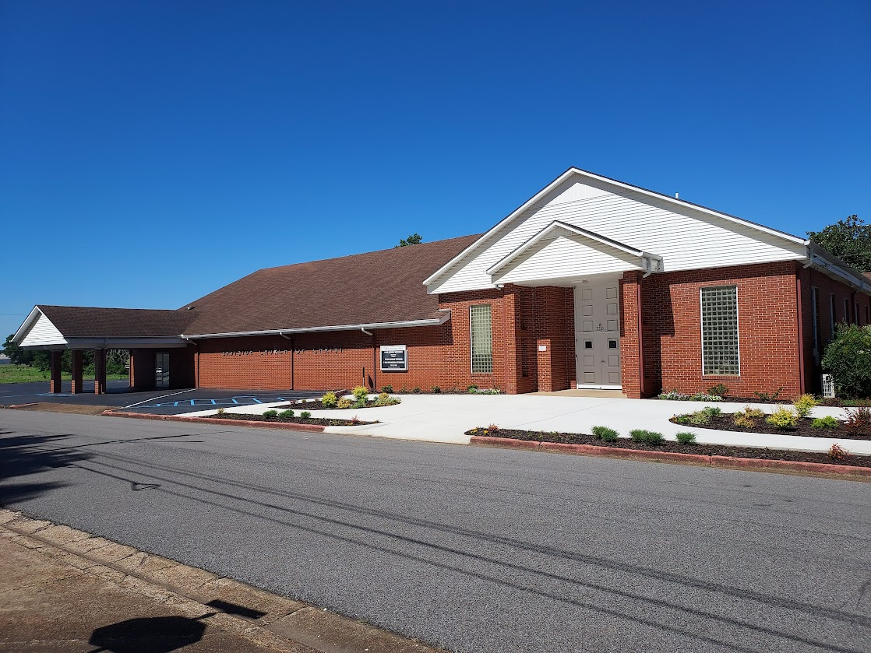

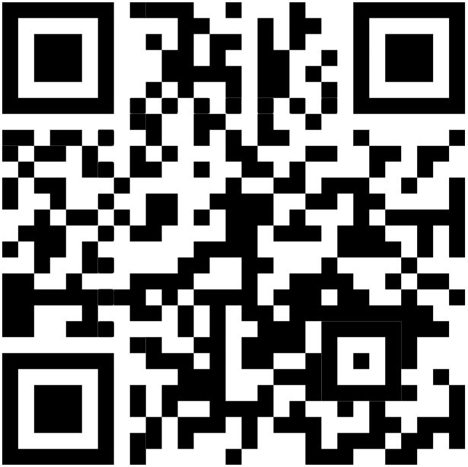
Welcome
Services will begin in:
WELCOME VISITORS
Please scan the QR code to allow us to have a record of your visit
www.eastside-church.com/welcome

Slide 2
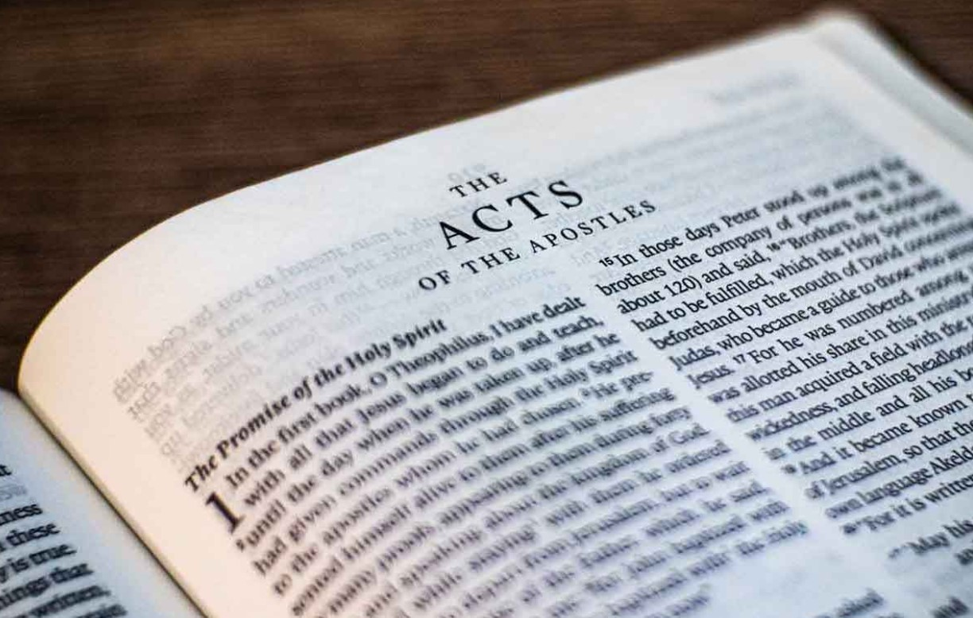
Go Tell The Good News
Acts – Part II

Slide 3
Today’s class:
Paul’s life after the book of Acts
Summary of Ephesians & Colossians

Slide 4
After Acts…
There is no inspired history of Paul’s work
His life and work did continue
Paul wrote seven (7) letters / epistles after he arrived in Rome. Information of Paul’s activities can be gleaned from these letters

Slide 5
Timeline
Festus began his term of governor of Judea in A.D. 60
He sent Paul to Rome in the fall of A.D. 60 and Paul would have reached Rome in the spring of A.D. 61
Nero was Emperor of Rome from A.D. 54 – 68
*If Paul was able to defend himself before the Emperor, it would have been in the presence of Nero
In Acts 28:30, we are told that Paul spent 2 whole years in his own rented house in Rome
*Paul was able to receive “all who came to him, preaching the kingdom of God and teaching the things concerning the Lord Jesus Christ with all confidence, no one forbidding him”.
Notes:
Bullets 1-4 from Bob & Sandra Waldron book, “Go Tell The Good News”, page 213.

Slide 6
Timeline
Evidence seems to indicate that Paul was released from his imprisonment (~A.D. 63) and then subsequently imprisoned again at some point prior to being executed
At the end of Acts, Luke states emphatically that he spent 2 whole years in house arrest (seems to indicate there was an end to the arrest)

Slide 7
Timeline
Evidence seems to indicate that Paul was released from his imprisonment (~A.D. 63) and then subsequently imprisoned again at some point prior to being executed
Paul writes letters while under arrest in Rome seemingly anticipating being set free:
Philemon vs. 22: asking Philemon to prepare a guest room for him trusting that through prayer he would be able to visit
Paul tells the Philippians that he trusted in the Lord that he himself would come to them shortly (Phil. 2:23-24)
Notes:
Reference Bob & Sandra Waldron book, “Go Tell The Good News”, page 215.

Slide 8
Timeline
Evidence seems to indicate that Paul was released from his imprisonment (~A.D. 63) and then subsequently imprisoned again at some point prior to being executed
Nero had not then commenced his memorable persecution of the Church; the burning of the city of Rome took place in the summer of A.D.64; and, until that date, the disciples do not appear to have been singled out as the special objects of his cruelty.

Slide 9
Timeline
Evidence seems to indicate that Paul was released from his imprisonment (~A.D. 63) and then subsequently imprisoned again at some point prior to being executed
At the end of Acts, Paul had been incarcerated for 4 straight years (2 years in Caesarea and 2 years in Rome). Some of these writings seem to be an indication of travels after his house arrest in Rome (~61-63) ended
In his 2nd letter to Timothy, near the end of his life, he asks Timothy to “bring the cloak that I left with Carpus at Troas when you come, and the books, especially the parchments”. (2 Tim. 4:13)
Paul writes that Erastus “stayed in Corinth” and that he had left Trophimus in Miletus sick (2 Tim. 4:20)

Slide 10
Paul’s Prison Letters
Ephesians; Philippians; Colossians; Philemon
Evidence seems to indicate that these letters were written fairly close together by Paul from Rome during his first imprisonment
Paul refers to himself as a prisoner, or in chains, in Ephesians (Eph. 3:1; 4:1; 6:20)
In Philippians, he refers to his bonds (1:7, 16), to the Praetorian guard (1:13), and to Caesar’s household (4:22)
In Colossians, he refers to himself in chains (4:3) and mentions Aristarchus “my fellow prisoner” (4:10)
Notes:
Reference Bob & Sandra Waldron book, “Go Tell The Good News”, page 214.

Slide 11
Paul’s Prison Letters
Ephesians; Philippians; Colossians; Philemon
Evidence seems to indicate that these letters were written fairly close together by Paul from Rome during his first imprisonment
In Philemon, Paul notes he is a prisoner of Jesus Christ and in chains (vs. 9-10), and that Epaphras was another fellow prisoner (23)
All four letters mention Paul as a prisoner. There are only 2 prolonged imprisonments that Paul suffered in the story of Acts: Caesarea and Rome
Notes:
Reference Bob & Sandra Waldron book, “Go Tell The Good News”, page 214.

Slide 12
Paul’s Prison Letters
How they were delivered:
The letter to Ephesus was carried by Tychicus (Eph. 6:21-22)
The letter to Colossae was carried by Tychicus with Onesimus (Col. 4:7-9)
The letter to Philemon was probably carried by Tychicus
Paul sent a message to Archippus in the letter to the Colossians and then greets him as he begins his letter to Philemon (Col. 4:17; Phil. 2)
It is concluded that both Philemon and Archippus were members of the church at Colossae

Slide 13
Summary of Ephesians
This letter is a description of the blessings God has provided for all saints through Christ and then a reminder that with these blessings come responsibilities.
Outline of Ephesians:
Chapters 1-3: God has given us every spiritual blessings in Christ
Chapters 4-6: Live according to the blessings from God
Notes:
Reference Bob & Sandra Waldron book, “Go Tell The Good News”, page 216

Slide 14
Summary of Ephesians
Chapter 1
This chapter highlights the spiritual blessings believers have in Christ, including being chosen and adopted by God, redemption through Jesus' sacrifice, and the sealing of the Holy Spirit. Paul expresses gratitude for the Ephesians' faith and prays for their understanding of God's purpose and power in their lives.
“Blessed be the God and Father of our Lord Jesus Christ, who has blessed us with every spiritual blessing in the heavenly places in Christ” (Eph. 1:3)

Slide 15
Summary of Ephesians
Chapter 2
This chapter describes the transformation from spiritual death to life through God's grace, emphasizing that all people, regardless of their past, can be reconciled with God through faith in Jesus Christ. It highlights the unity of believers as members of God's household, encouraging them to live in harmony and reflect God's love.
“But God, who is rich in mercy, because of His great love with which He loved us, even when we were dead in trespasses, made us alive together with Christ (by grace you have been saved), and raised us up together, and made us sit together in the heavenly places in Christ Jesus, that in the ages to come He might show the exceeding riches of His grace in His kindness toward us in Christ Jesus. ” (Eph. 2:5-7)

Slide 16
Summary of Ephesians
Chapter 3
This chapter reveals the mystery of the gospel, emphasizing that Gentiles are co-heirs with Israel through Christ. Paul prays for the Ephesians to be strengthened in their faith and to understand the vastness of Christ's love.
“For this reason I bow my knees to the Father of our Lord Jesus Christ, … that Christ may dwell in your hearts through faith; that you, being rooted and grounded in love, may be able to comprehend with all the saints what is the width and length and depth and height— to know the love of Christ which passes knowledge; that you may be filled with all the fullness of God.”
(re: Eph. 3:14-19)

Slide 17
Summary of Ephesians
Chapter 4
This chapter emphasizes the importance of unity among believers, urging them to live in a manner worthy of their calling with humility, patience, and love.
“I, therefore, the prisoner of the Lord, beseech you to walk worthy of the calling with which you were called, with all lowliness and gentleness, with longsuffering, bearing with one another in love, endeavoring to keep the unity of the Spirit in the bond of peace.” (Eph. 4:1-3)

Slide 18
Summary of Ephesians
Chapter 5
This chapter emphasizes living a life filled with love, light, and wisdom, urging believers to imitate God and walk in love as Christ did.
“Therefore be imitators of God as dear children. And walk in love, as Christ also has loved us and given Himself for us, an offering and a sacrifice to God for a sweet-smelling aroma.”
(Eph. 5:1-2)

Slide 19
Summary of Ephesians
Chapter 6
This chapter emphasizes the importance of spiritual warfare, instructing believers to put on the full armor of God to stand against spiritual forces. It also addresses family relationships, urging children to obey their parents and parents to raise their children with care and instruction.
“Finally, my brethren, be strong in the Lord and in the power of His might. Put on the whole armor of God, that you may be able to stand against the wiles of the devil.” (Eph. 6:10-11)

Slide 20
Summary of Colossians
Theme: Christ is all you need. In Him you have all blessings of God. Therefore, you do not need anything or anyone else.
Outline of Colossians:
Christ is everything you need (1:1-29)
Do not let anyone spoil what you have (2:1-23)
A picture of the true child of God (3:1 – 4:18)
“…Christ, in whom are hidden all the treasures of wisdom and knowledge” (Col. 2:2b-3)
Notes:
Reference Bob & Sandra Waldron book, “Go Tell The Good News”, page 222-223

Slide 21
Summary of Colossians
Chapter 1
This chapter highlights the supremacy of Jesus Christ as the image of God and the creator of all things. Paul expresses gratitude for the faith and love of the Colossian believers, encourages them to grow in knowledge and understanding, and highlights the importance of Christ's redemptive work through His death and resurrection.
“…do not cease to pray for you…that you may walk worthy of the Lord, fully pleasing Him, being fruitful in every good work and increasing in the knowledge of God…” (re: Col. 1:9-10)

Slide 22
Summary of Colossians
Chapter 2
This chapter emphasizes the importance of being rooted in Christ and warns against deceptive philosophies and human traditions that can lead believers astray.
“Now this I say lest anyone should deceive you with persuasive words. For though I am absent in the flesh, yet I am with you in spirit, rejoicing to see your good order and the steadfastness of your faith in Christ.” (Col. 2:4-5)

Slide 23
Summary of Colossians
Chapter 3
This chapter emphasizes the importance of focusing on spiritual matters rather than earthly concerns, urging believers to set their minds on things above where Christ is.
“If then you were raised with Christ, seek those things which are above, where Christ is, sitting at the right hand of God. Set your mind on things above, not on things on the earth.” (Col. 3:1-2)

Slide 24
Summary of Colossians
Chapter 4
This chapter emphasizes the importance of prayer, wise conduct, and gracious communication among believers. The chapter concludes with personal greetings and encouragements from Paul
“Walk in wisdom toward those who are outside, redeeming the time. Let your speech always be with grace, seasoned with salt, that you may know how you ought to answer each one.” (Col. 4:5-6)

